Slide 1
新版BCU

Slide 2
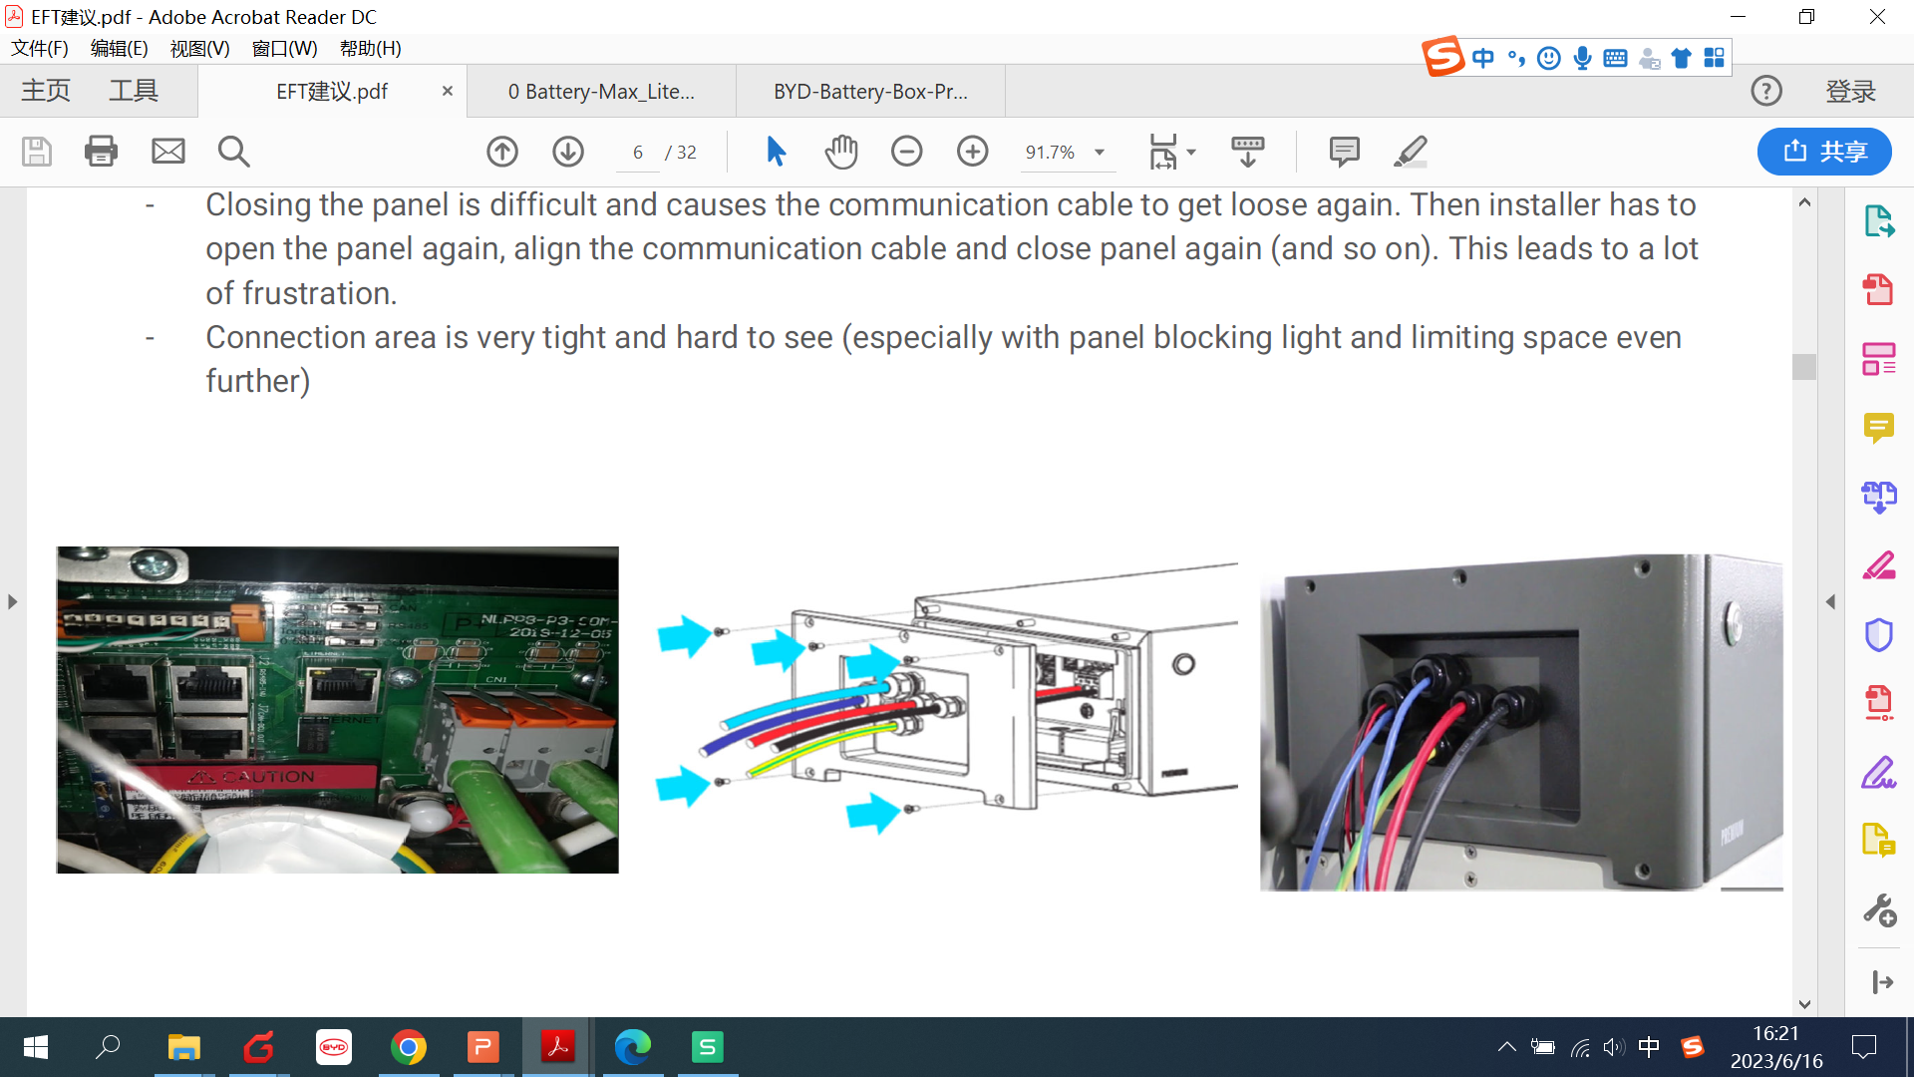
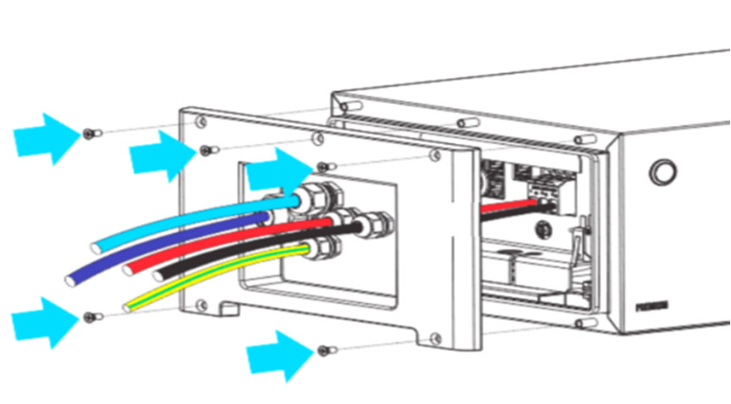
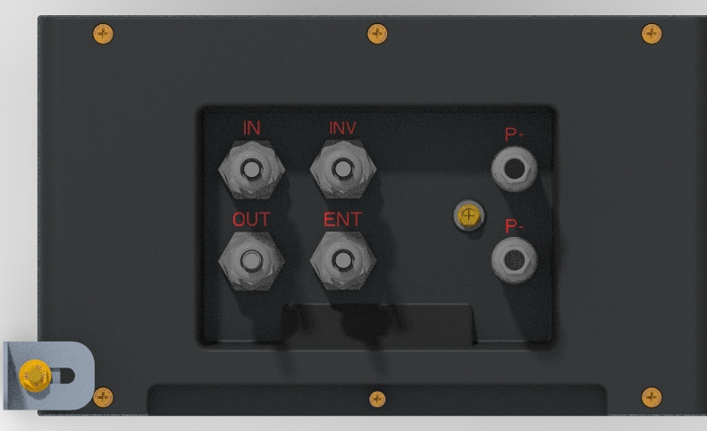
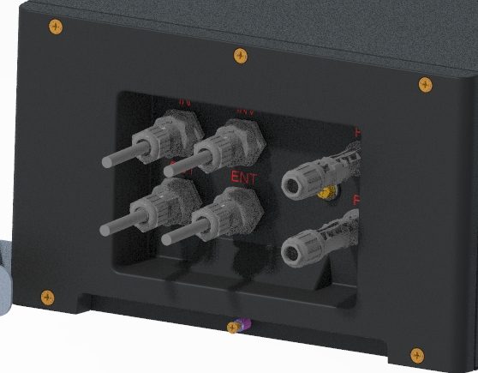
HVM&HVS BCU
Before:
After:
When wiring, installers need to remove the cover plate first, and lock the wire harness after passing it through the holes, which is a complicated step.
When closing the cover, installers need to tighten the screws, if they are not tightened or the screw holes are broken, the cover will not be locked and the battery will report an error.
No standard connector.
The ends of all data cables to BCU are RJ45 plug. The RJ45 plug should be fitted into the communication connector before being plugged into corresponding ports.
Standard DC connector

Slide 3
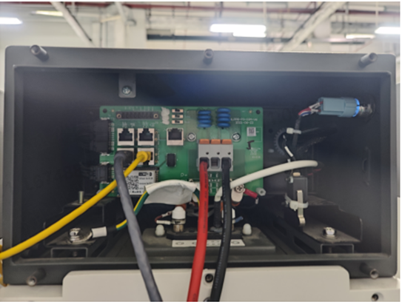
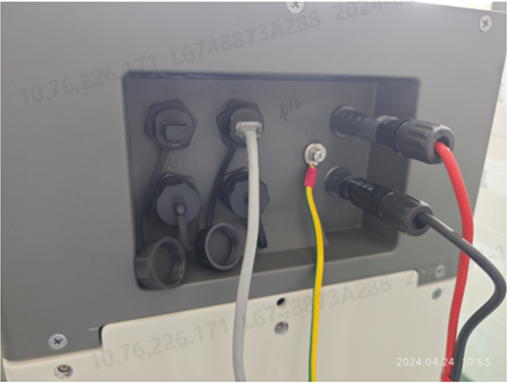
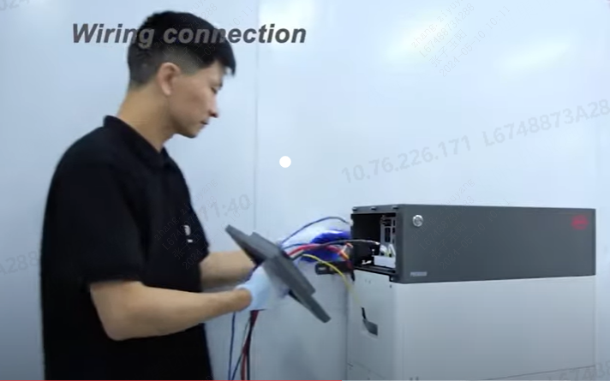
HVM&HVS BCU Improvement
Before:
After: Easy Cabling
Save installation time
More safety
Easy cabling
No need to remove the operating panel
Data cables to BCU: RJ45 plug
Standard DC connector
Note: The two operating panels cannot be mixed up but can be conneted in parallel.

Slide 4
Q&A
1、What problems can be solved by improvement?
2、What improvement have been made?
3、Changes in port for inverter data cable.
1、a. When wiring, installers need to remove the cover plate first, and lock the wire harness after passing it through the holes, which is a complicated step.
b. No standard connector
2、a. Data cables to BCU: RJ45 plug b. Standard DC connector. c. Wiring without opening the panel
3、The original HVM/HVS has two interfaces, 8-pin and RJ45. The new version cancels the 8-pin connector and retains RJ45.

